Slide 1



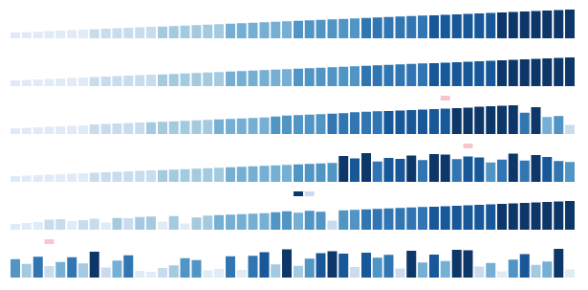
Sorting and Searching Algorithms
Sorting, Searching, Shuffling
Sorting and Searching
SoftUni Team
Technical Trainers
Software University
http://softuni.bg

Slide 2

Table of Contents
Sorting
Types of Sorting Algorithms
Popular Sorting Algorithms
Searching
Linear Search
Binary Search
Interpolation Search
Shuffling Algorithms

Slide 3
Sorting

Slide 4
What is a Sorting Algorithm?
Sorting algorithm
An algorithm that rearranges elements in a list
In non-decreasing order
Elements must be comparable
More formally
The input is a sequence / list of elements
The output is an rearrangement / permutation of elements
In non-decreasing order

Slide 5

Sorting – Example
Efficient sorting algorithms are important for
Producing human-readable output
Canonicalizing data – making data uniquely arranged
In conjunction with other algorithms, like binary searching
Example of sorting:
Unsorted list
sorting
Sorted list
10 | 3 | 7 | 3 | 4
3 | 3 | 4 | 7 | 10

Slide 6
Sorting Algorithms: Classification
Sorting algorithms are often classified by
Computational complexity and memory usage
Worst, average and best case behavior
Recursive / non-recursive
Stability – stable / unstable
Comparison-based sort / non-comparison based
Sorting method: insertion, exchange (bubble sort and quicksort), selection (heapsort), merging, serial / parallel, etc.

Slide 7
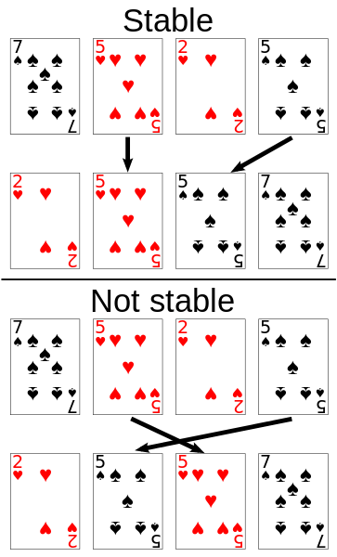
Stability of Sorting
Stable sorting algorithms
Maintain the order of equal elements
If two items compare as equal, their relative order is preserved
Unstable sorting algorithms
Rearrange the equal elements in unpredictable order
Often different elements have same key used for equality comparing

Slide 8
Selection Sort
Selection sort – simple, but inefficient algorithm (visualize)
Swap the first with min element on the right, then the second, etc.
Best, worst and average case: O(n²)
Memory: O(1)
Stable: No
Method: Selection
for (left = 0; left < n-1; left++) {
// Find the min element in the unsorted range arr[left … n-1]
minIndex = left;
for (i = left + 1; i < n; i++)
if (arr[i] < arr[minIndex]) minIndex = i;
if (minIndex != left) Swap(arr[left], arr[minIndex]);
}

Slide 9
Selection Sort: Why Unstable?
Why the "selection sort" is unstable?
Swaps the first element with the min element on the right
Swaps the second element with the min element on the right
…
During the swaps equal elements can jump over each other
left
min
swap
equal elements
changed order
3♥ | 5♠ | 3♦ | 4♥ | 2♣
3♥ | 5♠ | 3♦ | 4♥ | 2♣
2♣ | 5♠ | 3♦ | 4♥ | 3♥

Slide 10
Bubble Sort
Bubble sort – simple, but inefficient algorithm (visualize)
Swaps to neighbor elements when not in order until sorted
Best case: O(n); worst & average: O(n²)
Memory: O(1)
Stable: Yes
Method: Exchanging
do
swapped = false
for i = 1 to indexOfLastUnsortedElement
if leftElement > rightElement
Swap(leftElement, rightElement)
swapped = true
while swapped

Slide 11
Insertion Sort
Insertion sort – simple, but inefficient algorithm (visualize)
Move the first unsorted element left to its place
Best case: O(n); worst & average: O(n²)
Memory: O(1)
Stable: Yes
Method: Insertion
for firstUnsortedIndex = 1 to length(arr) – 1 {
i = firstUnsortedIndex
while (i > 0 && arr[i-1] > arr[i]) {
Swap(arr[i], arr[i-1])
i--
}
}

Slide 12
QuickSort
QuickSort – efficient sorting algorithm (visualize)
Choose a pivot; move smaller elements left & larger right; sort left & right
Best & average case: O(n*log(n)); Worst: O(n²)
Memory: O(log(n)) stack space (for recursion)
Stable: Depends
Method: Partitioning
QuickSort(arr, lo, hi)
if lo < hi
p = Partition(arr, lo, hi)
QuickSort(arr, lo, p) // sort the left partition
QuickSort(arr, p + 1, hi) // sort thr right partition

Slide 13
QuickSort: Lomuto Partitioning
Partition(arr, lo, hi)
pivot = arr[lo]
store = lo + 1
for (i = store; i <= hi; i++)
if (arr[i] <= pivot)
Swap(arr[i], arr[store])
store++
store--;
Swap(arr[lo], arr[store])
return store

Slide 14
QuickSort: Hoare Partitioning
Partition(arr, lo, hi)
pivot = arr[lo]
left = lo - 1
right = hi + 1
while (true)
do
right--
while arr[right] > pivot
do
left++
while arr[left] < pivot
if left < right
Swap(arr[left], arr[right])
else
return right
The index returned is not necessarily the pivot's location

Slide 15
Merge Sort
Merge sort is efficient sorting algorithm (visualize)
Divide the list into sub-lists (typically 2 sub-lists)
Sort each sub-list (recursively call merge-sort)
Merge the sorted sub-lists into a single list
Best, average and worst case: O(n*log(n))
Memory:
Typically O(n)
With in-place merge can be O(1)
Highly parallelizable on multiple cores / machines → up to O(log(n))
Stable: Yes
Method: Merging

Slide 16
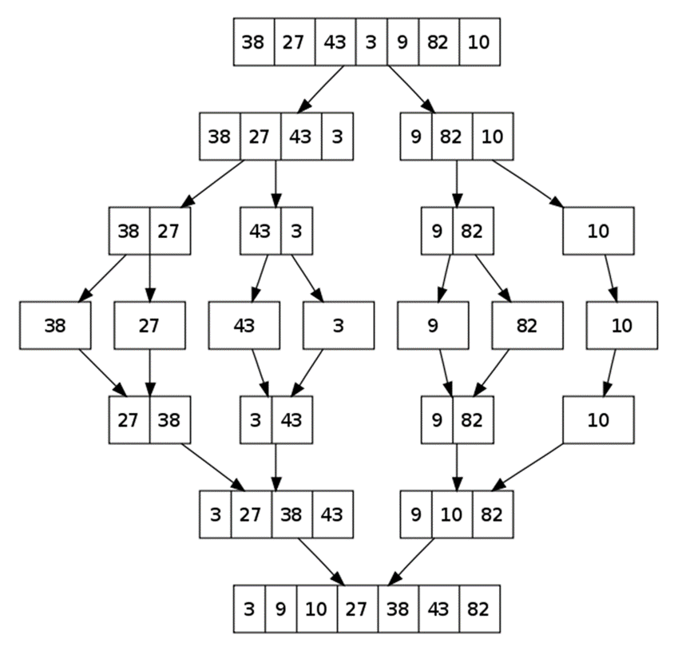
Merge Sort: Hot It Works?

Slide 17
Merge Sort: Pseudocode
MergeSort(list)
var len = length(list)
if len <= 1
return list // List already sorted
var middle = len / 2
var left = SubList(list, 0, middle)
var right = SubList(list, middle + 1, len-1)
left = MergeSort(left)
right = MergeSort(right)
return Merge(left, right)

Slide 18
Merge: Pseudocode
Merge(leftList, rightList)
var mergedlist = new list[length(leftList) + length(rightList)]
var leftIndex, rightIndex, mergedIndex = 0
while (leftIndex < length(left) && rightIndex < length(rightList)
if (leftList[leftIndex] <= rightList[rightIndex])
mergedList[mergedIndex++] = leftList[leftIndex++];
else
mergedList[mergedIndex++] = rightList[rightIndex++];
while (leftIndex < leftList.Length)
mergedList[mergedIndex++] = leftList[leftIndex++];
while (rightIndex < rightList.Length)
mergedList[mergedIndex++] = rightList[rightIndex++];
return mergedList;

Slide 19
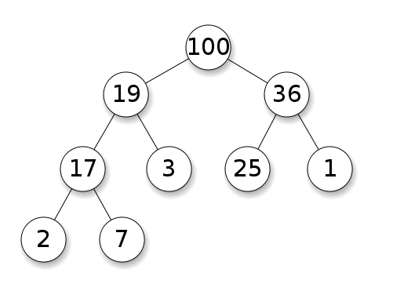
Heap Data Structure
Heap == tree-based data structure that satisfies the heap property:
Parent nodes are always greater than or equal to the children
No implied ordering between siblings or cousins
Binary heap visualization: http://visualgo.net/heap.html
Find-max | O(1)
Delete-max | O(log n)
Insert | O(log n)
Decrease-key | O(log n)
Merge | O(n)

Slide 20
HeapSort
HeapSort works in two phases (visualize):
A heap is built out of the array elements → O(n)
A sorted array is created by removing the largest element from the heap n times → n * O(log n)
Best, average and worst case: O(n*log(n))
Memory: O(1) – if the array and heap share the same memory
Stable: No
Method: Selection

Slide 21
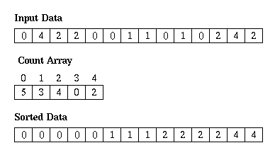
Counting Sort
Counting sort is a very efficient sorting algorithm (visualize)
Sorts small integers by counting their occurrences
Not a comparison-based sort
Best, average and worst case: O(n + k)
k is the range of numbers to be sorted
E.g. [-1000 ... 1000] → k = 2001
Memory: O(n + k) Space: O(k)
Stable: Yes
Method: Counting

Slide 22
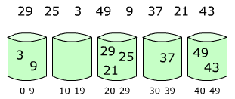
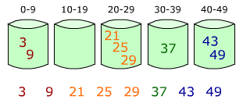
Bucket Sort
Bucket sort partitions an array into a number of buckets
Each bucket is then sorted individually with a different algorithm
Not a comparison-based sort
Average case: O(n + k)
k = the number of buckets
Worst case: O(n * log n)
Stable: Yes (depends on algorithm)
Memory: O(n) – k buckets holding n elements totally

Slide 23
Comparison of Sorting Algorithms
Name | Best | Average | Worst | Memory | Stable | Method
SelectionSort | n² | n² | n² | 1 | No | Selection
BubbleSort | n | n² | n² | 1 | Yes | Exchanging
InsertionSort | n | n² | n² | 1 | Yes | Insertion
QuickSort | n*log(n) | n*log(n) | n² | log(n) | Depends | Partitioning
MergeSort | n*log(n) | n*log(n) | n*log(n) | 1 (or n) | Yes | Merging
HeapSort | n*log(n) | n*log(n) | n*log(n) | 1 | No | Selection
BogoSort | n | n*n! | n*n! | 1 | No | Luck

Slide 24

Searching Algorithms

Slide 25

Search Algorithm
Search algorithm == an algorithm for finding an item with specified properties among a collection of items
Different types of searching algorithms
For virtual search spaces
Satisfy specific mathematical equations
Try to exploit partial knowledge about a structure
For sub-structures of a given structure
A graph, a string, a finite group
Search for the min / max of a function, etc.

Slide 26
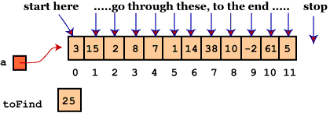
Linear Search
Linear search finds a particular value in a list (visualize)
Checking every one of the elements
One at a time, in sequence
Until the desired one is found
Worst & average performance: O(n)
for each item in the list:
if that item has the desired value,
return the item's location
return nothing

Slide 27
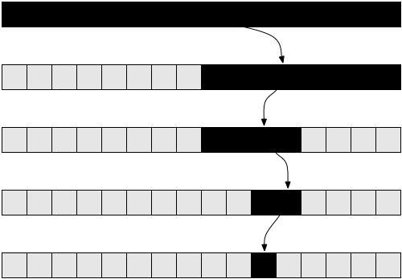
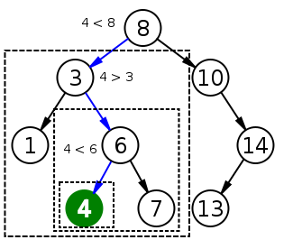
Binary Search
Binary search finds an item within a ordered data structure
At each step, compare the input with the middle element
The algorithm repeats its action to the left or right sub-structure
Average performance: O(log(n))
See the visualization

Slide 28
Binary Search (Recursive)
int BinarySearch(int arr[], int key, int start, int end) {
if (end < start)
return KEY_NOT_FOUND;
else {
int mid = (start + end) / 2;
if (arr[mid] > key)
return BinarySearch(arr, key, start, mid - 1);
else if (arr[mid] < key)
return BinarySearch(arr, key, mid + 1, end);
else
return mid;
}
}

Slide 29
Binary Search (Iterative)
int BinarySearch(int arr[], int key, int start, int end) {
while (end >= start) {
int mid = (start + end) / 2;
if (arr[mid] < key)
start = mid + 1;
else if (arr[mid] > key)
end = mid - 1;
else
return mid;
}
return KEY_NOT_FOUND;
}

Slide 30
Interpolation Search
Interpolation search == an algorithm for searching for a given key in an ordered indexed array
Parallels how humans search through a telephone book
Calculates where in the remaining search space the item might be
Binary search always chooses the middle element
Can we have a better hit, e.g. Angel in the phonebook should be at the start, not at the middle, OK?
Average case: log(log(n)), Worst case: O(n)
http://youtube.com/watch?v=l1ed_bTv7Hw

Slide 31
Interpolation Search – Sample Implementation
int InterpolationSearch(int[] sortedArray, int key) {
int low = 0;
int high = sortedArray.Length - 1;
while (sortedArray[low] <= key && sortedArray[high] >= key) {
int mid = low + ((key - sortedArray[low]) * (high - low))
/ (sortedArray[high] - sortedArray[low]);
if (sortedArray[mid] < key)
low = mid + 1;
else if (sortedArray[mid] > key)
high = mid - 1;
else
return mid;
}
if (sortedArray[low] == key) return low;
else return KEY_NOT_FOUND;
}

Slide 32

Shuffling Algorithms

Slide 33

Shuffling
Shuffling == randomizing the order of items in a collection
Generate a random permutation
http://en.wikipedia.org/wiki/Shuffling

Slide 34
Fisher–Yates Shuffle Algorithm
public static IEnumerable<T> Shuffle<T>(this IEnumerable<T> source)
{
Random rnd = new Random();
var array = source.ToArray();
var n = array.Length;
for (var i = 0; i < n; i++)
{
// Exchange array[i] with random element in array[i … n-1]
int r = i + rnd.Next(0, n - i);
var temp = array[i];
array[i] = array[r];
array[r] = temp;
}
return array;
}
Shuffle algorithms: visualization

Slide 35

Summary
Slow sorting algorithms:
Selection sort, Bubble sort, Insertion sort
Fast sorting algorithms:
Quick sort, Merge sort, Heap sort, Counting sort, Bucket sort
How to choose the most appropriate algorithm?
http://stackoverflow.com/a/1934004
Searching algorithms:
Unsorted list → linear search (slow)
Sorted list → binary search / interpolation search (fast)

Slide 36








Sorting and Searching Algorithms
https://softuni.bg/trainings/1331/algorithms-april-2016

Slide 37
License
This course (slides, examples, labs, videos, homework, etc.) is licensed under the "Creative Commons Attribution-NonCommercial-ShareAlike 4.0 International" license
Attribution: this work may contain portions from
"Fundamentals of Computer Programming with C#" book by Svetlin Nakov & Co. under CC-BY-SA license
"Data Structures and Algorithms" course by Telerik Academy under CC-BY-NC-SA license

Slide 38






Free Trainings @ Software University
Software University Foundation – softuni.org
Software University – High-Quality Education, Profession and Job for Software Developers
softuni.bg
Software University @ Facebook
facebook.com/SoftwareUniversity
Software University @ YouTube
youtube.com/SoftwareUniversity
Software University Forums – forum.softuni.bg

